Slide 1

In our modern era we have developed and innovate technology immensely that we x50 billion computing power from the last 50 years since 1970s.
Computing
Project Presentation
Raspberry Pi Tiny, Portable, and Powerful PC
Michael Inso - ACCP

Slide 2

Acknowledgment
This project would not have been possible with a lot of dedicated special individuals putting their hearts, trust, and faith in me helping me to persevere and be persistent.
I would like to express my special thanks of gratitude to Aptech Qatar Education Centre who gave the amazing opportunity to do this strenuous project on the topic of Project Computing for NCC education, which also helped me in doing a lot of exploration and investigation and I acquired so many new knowledge and skills about Raspberry Pi, Nvidia Jetson Nano, and Asus Tinker Board.
Secondly, I would also like to thank my family, friends, and relatives who still give me assistance, comradery, sponsorship, and accommodation even I’m already a capable adult they helped me a lot in completing this project within a limited duration of time.
PROJECT COMPUTING | Raspberry Pi Tiny, Portable, and Powerful PC

Slide 3
Introduction
In this project, we will be building and assembling xRaspberry xPi 4 x8gb xmodel xB. The most currently powerful xRaspberry xPi costing only $75. We can do a lot of things with it from being just a regular Linux pc, server, VPN, and pen-testing, etc. And to more sophisticated projects like Artificial Intelligence, Machine Learning, and Deep Learning, etc. here is the list of projects for https://proiects.raspberrypi.org/en. Alternatively, we can use powerful chips like Nvidia Jetson Nano or Asus Tinker box for more sophisticated projects. In the project, we will use the Debian Linux/GNU (Raspbian) Operating System. We will be formatting our SD card as Fat32 since xRaspberry xPi’s xbootloader, xbuilt xinto the xGPU and xnon-updatable, only xhas xsupport reading xfrom xFAT xfilesystems (xboth xFAT16 and xFAT32), and is unable booting from an exFatx and NTFS xfilesystem. We will be setting up xNew xOut xof xBox xSoftware (xNOOBS) for anx easyx Operatingx Systemx installationx in our xRaspberry xPi 4 8gb model B.
PROJECT COMPUTING | Raspberry Pi Tiny, Portable, and Powerful PC

Slide 4

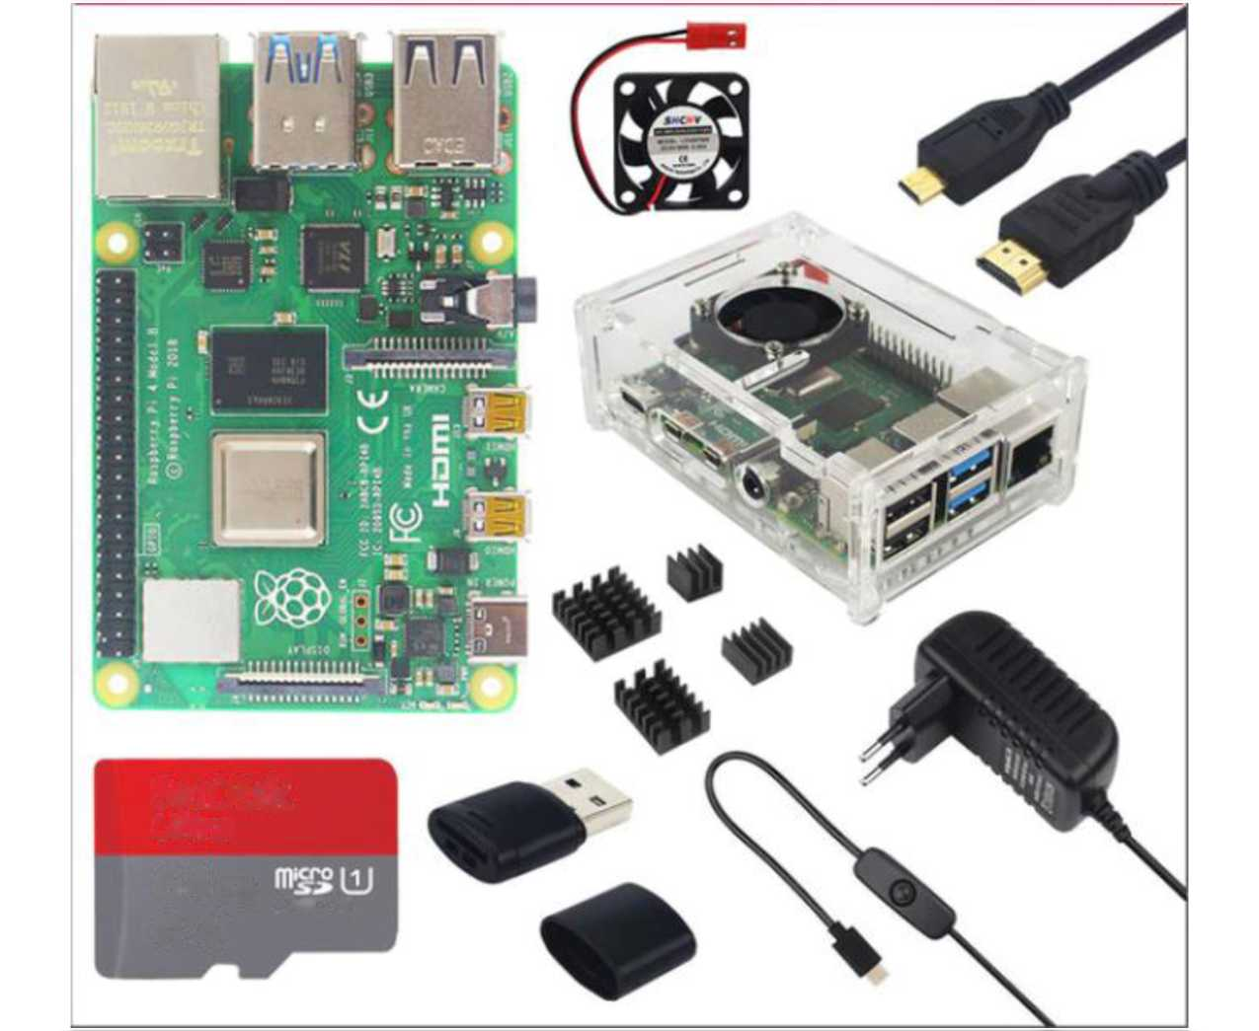
Task 1
SanOisk
Ultra
64GB
J>C€Z I
®A\
Figure 1: a.) xRaspberrysx xPix x4x xModelx xBx x8GxBx xRAMx + xCasex + xFanx + x HeatxSinkx + xPowerx xAdapterx + 32x xFATx 32 xGB SD xCard + xMicrox xHDMIx xC ablex for xRPIx x4Bx
PROJECT COMPUTING | Raspberry Pi Tiny, Portable, and Powerful PC

Slide 5

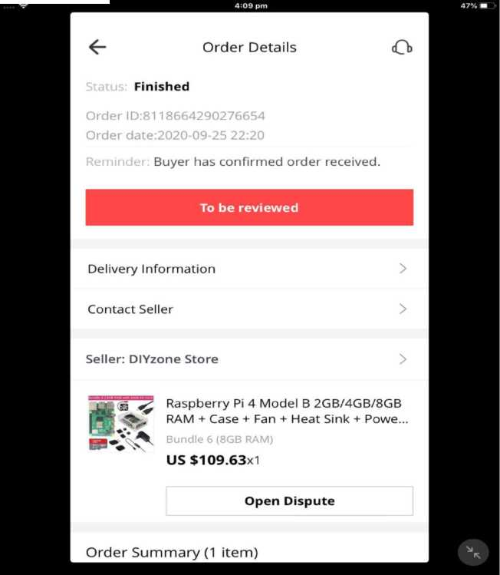
a.) Buying a xRaspberry xPi 4 8GB xmodel xB
Official site of xRaspberry xPi doesn’t directly sell its products they only have companies approved resellers to distribute their products. Official site https://www.raspberrypi.org/ currently doesn’t support and doesn’t have approved resellers to Qatar. Purchasing this product, I have to use Online Shopping sites like Amazon, AliExpress, and eBay, etc. and ship it to Qatar. I end up buying in AliExpress because they have the cheapest, fastest shipping, and the needed requirements for me to build my xRaspberry xPi 4 8gb xmodel xB. xRaspberry xPi mostly sold separately you will be needing Power Adapter, SD card, LCD touch screen, or a micro HDMI cable. Heatsink, fan, and case are only optional if you want to keep your Raspberry Pi in a recommended temperature below 85 degrees Celsius for it to work properly that’s the maximum temperature limit.
Order Summary (1 item)
Figure 2: c.) Purchase Order of Raspberry Pi 4 8GB model B
PROJECT COMPUTING | Raspberry Pi Tiny, Portable, and Powerful PC

Slide 6

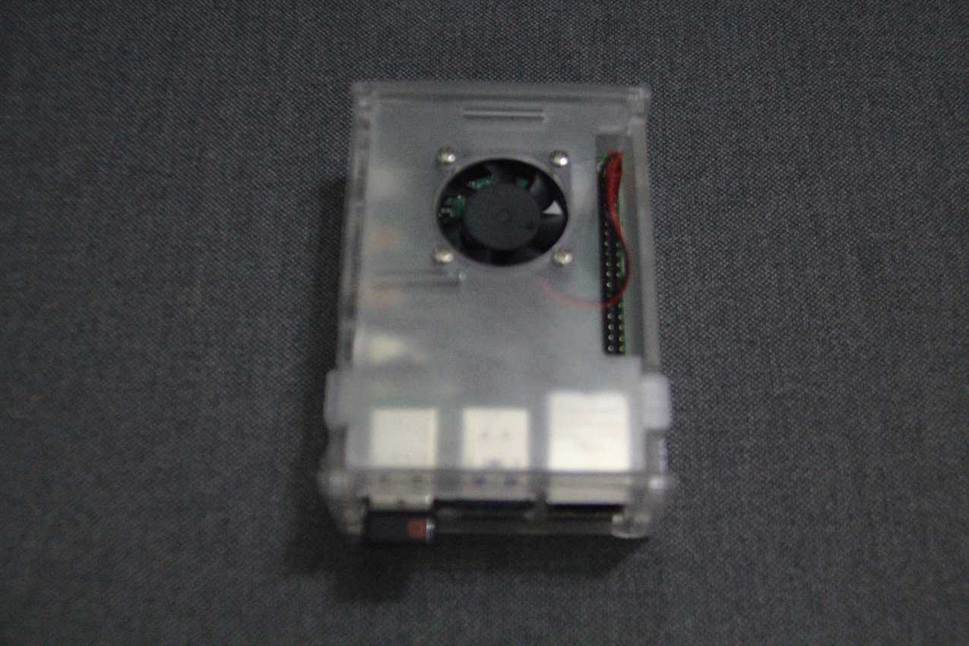
Task 2
Figure 3: a.) Assembling and Building of Raspberry Pi 4 8GB model B external
PROJECT COMPUTING | Raspberry Pi Tiny, Portable, and Powerful PC

Slide 7

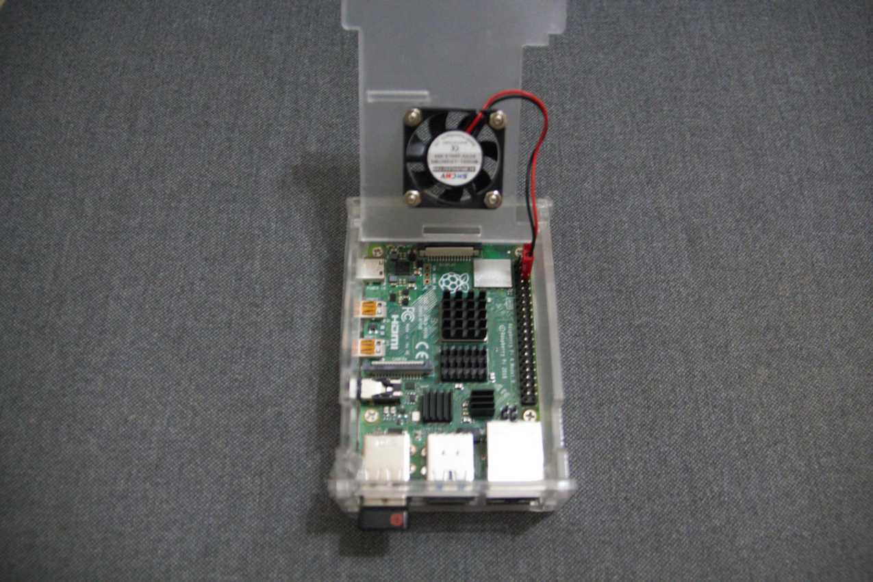
Figure 4: b.) Assembling and Building of Raspberry Pi 4 8GB model B internal
PROJECT COMPUTING | Raspberry Pi Tiny, Portable, and Powerful PC

Slide 8
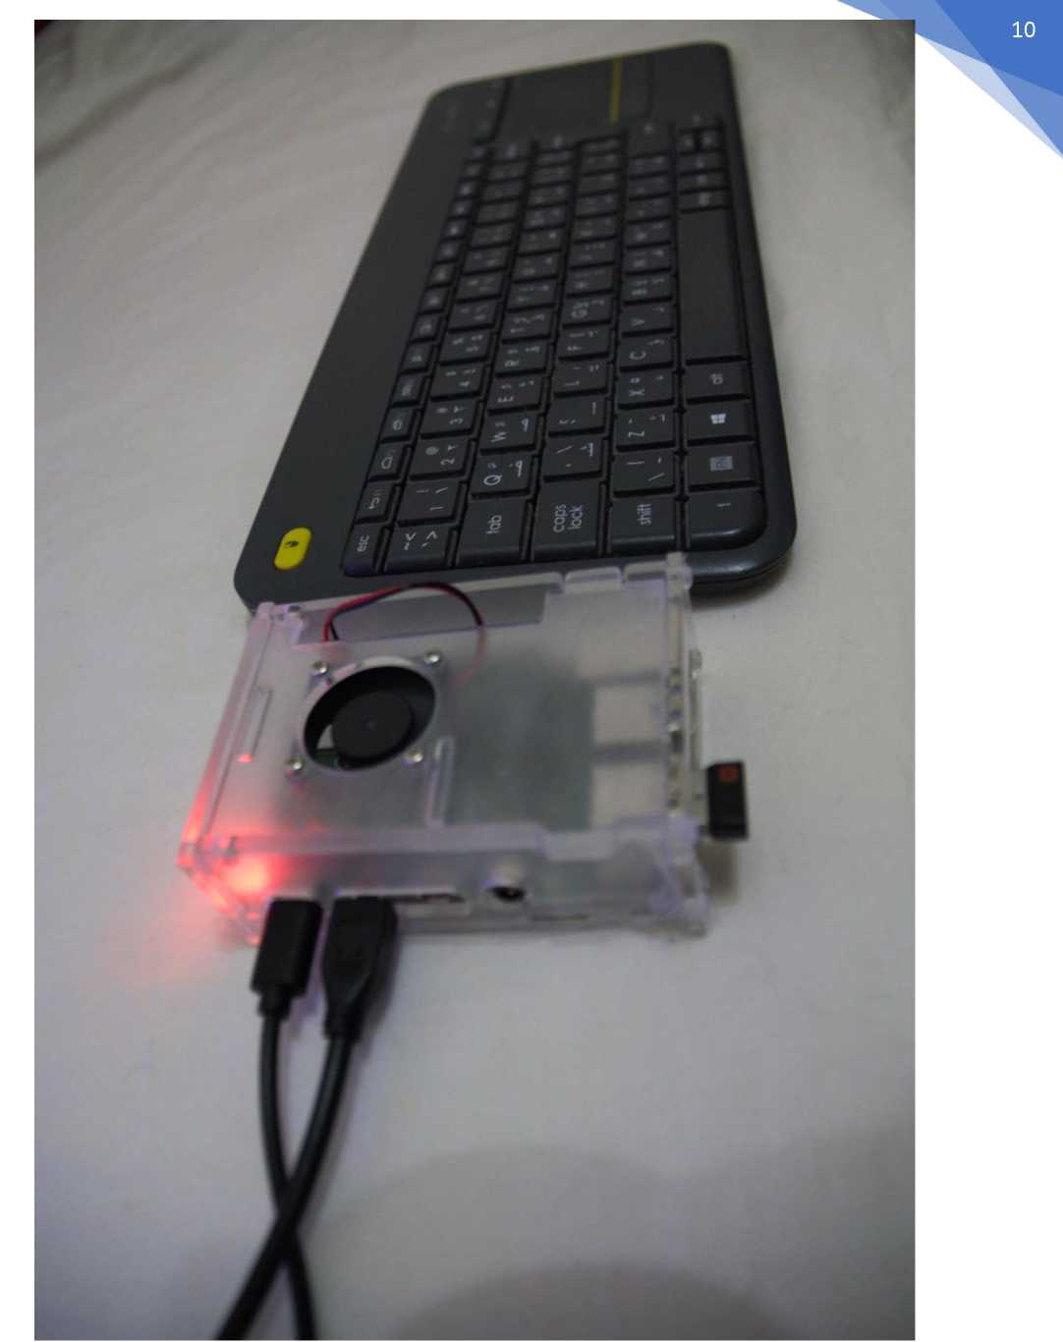
Figure 5: c.) Assembling and Building of Raspberry Pi 4 8GB model B with USB-C Power Adapter and Micro HDMI Cable with Wireless Keyboard Logitech K400 Plus
PROJECT COMPUTING | Raspberry Pi Tiny, Portable, and Powerful PC

Slide 9

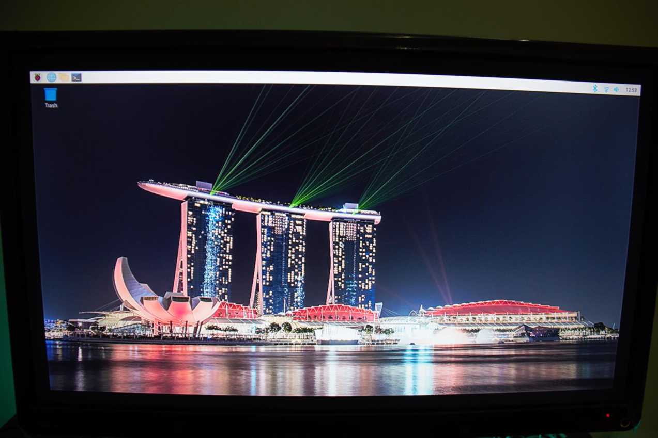
Figure 6: d.) Assembling and Building of Raspberry Pi 4 8GB model B with Micro HDMI Toshiba LCD Colour TV 1920 x 1080i as Monitor
PROJECT COMPUTING | Raspberry Pi Tiny, Portable, and Powerful PC

Slide 10

Task 3
a. ) Specification of Raspberry Pi 4 8gb model B
b. ) Broadcom xBC_M27_11, xQuad_corex_ xCortex-A_72x (xARM_v8x) x64-bit
SoC_@_2.5GHz
c. ) x8_GB xLPDDR_4-3200x SD_RAM
d. ) x2.4x_GHz and x5.0_GHz _IEEE _x802._11acx wireless, Bluetooth x5.0_, BLE
e. ) xGigabit _xEthernet
f. ) x2_USB _x3.0 ports; x2_xUSBx _x2.0x xportsx.
g. ) xRaspberryx sxPix standard _x40 xpinx sxGPIO_ headerx (xfullyx xbackwards
xcompatiblex with xpreviousx xboardsx)x
h. ) _x2 xmicro_xHDMI ports (up to x_4k_p60 supported)
i. ) x2-xlanex_MxIPI_xDSIx xdisplay portx
j. ) x2-xlanex_xMIPIx_xCSIx xcamera xport
k) x4_xpolex x_xstereox_audiox and-xcompositex-xvideo-xport
l. ) _xH.265x (x4k_p60 xdecode), xH264 (x1080_p60 decode, x1080_p30 encode)
m. ) OpenGL_ES_x3.0x xgraphics
n. ) xMicrox_xSDx xcard xslot xfor xloading xoperating xsystem xand xdata xstorage
o. ) x5V_xDC xvia _xUSB-C xconnector (xminimum x3A_*)
p. ) x5V_xDC xvia _xGPIO xheader (xminimum x3A_*)
q. ) xPower_over_Ethernet (xPoE) xenabled (xrequires_xseparate _xPoE _xHAT)
r. ) xOperating temperature: x0 - x50 xdegrees_C_ambient
* xA xgood xquality x_2.5A xpower xsupply xcan xbe xused xif xdownstream xUSB xperipherals xconsume xless xthan x_500mA inx xtotal.
PROJECT COMPUTING | Raspberry Pi Tiny, Portable, and Powerful PC

Slide 11

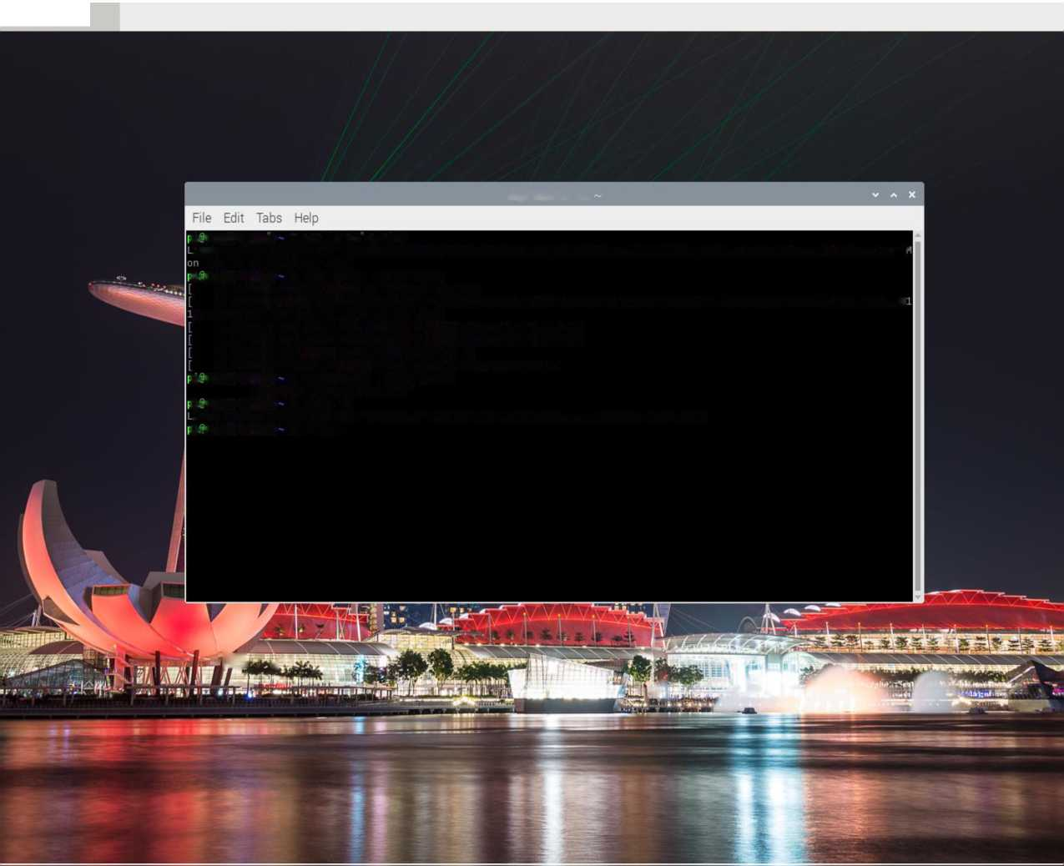
ii@)raspberrypi: ~
pi@raspberrypi:
ii@raspberrypi: S cat /proc/version
inux version 5.4.51-V71+ (dom@buildbot) (gcc version 4.9.3 (crosstool-NG crosstool-ng-1.22.0-88-g8460611)) #1333 SMP I in Aug 10 16:51:40 BST 2020 >i@raspberrypi: S sudo dmesg | grep Linux
0.000000] Booting Linux on physical CPU 0x0
0.000000] Linux version 5.4.51-v7l+ (dom@buildbot) (gcc version 4.9.3 (crosstool-NG crosstool-ng-1.22.0-88-g84606: )) #1333 SMP Mon Aug 10 16:51:40 BST 2020
1.215991] usb usbl: Manufacturer: Linux 5.4.51-V71+ xhci-hcd 1.217753] usb usb2: Manufacturer: Linux 5.4.51-V71+ xhci-hcd 4.203853] me: Linux media interface: V0.10 4.273568] videodev: Linux video capture interface: v2.00 ii@raspberrypi: S hostnamectl | grep Kernel Kernel: Linux 5.4.51-V71+ ii@raspberrypi: S uname -a
inux raspberrypi 5.4.51-V71+ #1333 SMP Mon Aug 10 16:51:40 BST 2020 armv7l GNU/Linux ii@raspberrypi: S scrot |
 |  |  | fr |  | £~'~'
Figure 7: b.) Kernel and OS (Operating System) of Raspberry Pi 4 8GB model B
PROJECT COMPUTING | Raspberry Pi Tiny, Portable, and Powerful PC

Slide 12

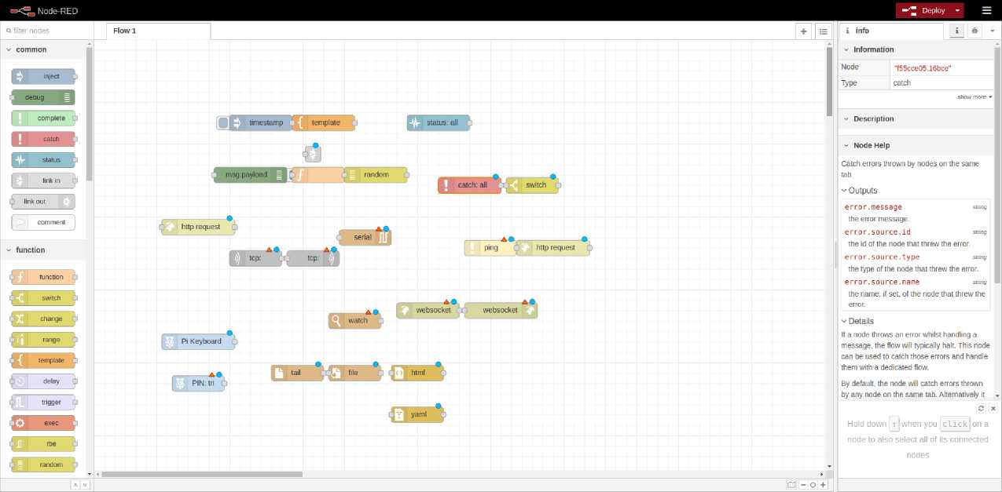
0 HP'@^{ras}P^{berr}VP^{i:}~ ^^Minecraft-Pi edition ^jNode-RED console Node-RED- Chromium
% f 4 13:21
g Node-RED * +
Node-RED - Chromium
<- -> CO 127.0.0.1:1880/#flow/585ac478.c3926c ☆ 0 © © :
Figure 9: d.) Running Node-RED in Raspberry Pi 4 8GB model B (2)
PROJECT COMPUTING | Raspberry Pi Tiny, Portable, and Powerful PC

Slide 13



|pt@raspberrypi: *
^^Minecraft- Pi edition [Scratch Desktop]
|Choose the Python g... Thonny - /home/pi/...
$ •=■ 48 13 36
Thonny - /home/pi/Documents/test.py @ 1 :
VOX
Switch to regular
test.pyS |_
1 import time
2
3 import sys # ignore
4 sys.path.insert(0,) # ignore
5 from Root.pswd import realpassword
6
7 def check_password(password): # Don't change it if len(password) != len(realpassword): return False
for x, y in zip(password, realpassword}:
time.sleep(0.1) # Simulates the wait time of the safe's mechanism if int(x} != int(y): return False return True
15
16 def crack_password(}:
Have = False
password = ["0","0","0","0"] psw = join(password)
20 #calculate time
starttime = time.time(}
print(check_password(psw)) #prints 'False' for testing elapsedtime = time.time() - start_time
24
25 while llave==False:
26
if checkpassword(psw) == True: llave=T rue else:
if calculateTime(psw) >= elapsed_time+0.3 : password[3]= str(int(password[3])+l) psw = join(password)
if int(password[2])>9: break
elif calculateTime(psw) >= elapsed time+0.2:
Python 3.7.3 (/usr/bin/python3)
»>
Python 3.7.3 (/usr/bin/python3) »>
Python 3.7.3 (/usr/bin/python3) »> %cd /home/pi/Documents
Figure 10: e.) Thonny Python-IDE in Raspberry Pi 4 8GB model B
PROJECT COMPUTING | Raspberry Pi Tiny, Portable, and Powerful PC

Slide 14
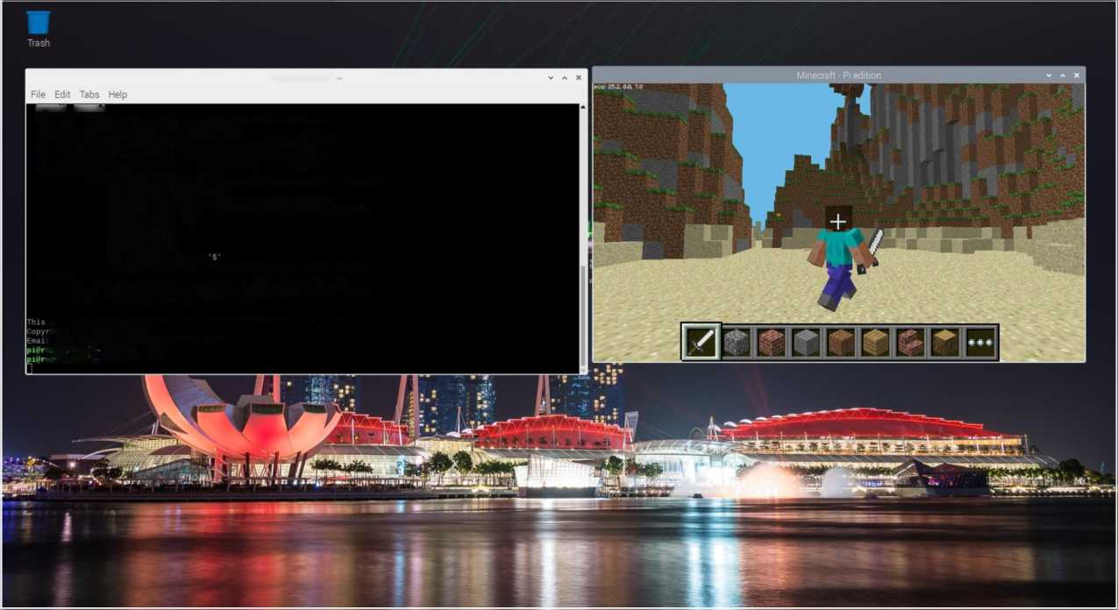
Task 4
*
■pi@raspberrypi ~
Mmecraft - Pi edition
I ? +
pi@raspberrypi:
SPECIAL STRINGS
Both the --exec and filename parameters can take format specifiers that are expanded by scrot when encountered.
There are two types of format specifier. Characters preceded by a '%' are interpreted by strftime(2). See man strftime for examples.
These options may be used to refer to the current date and time.
The second kind are internal to scrot and are prefixed by 'S'
The following specifiers are recognised:
Sf image path/filename (ignored when used in the filename) Sm thumbnail path/filename
$n image name (ignored when used in the filename)
Ss image size (bytes) (ignored when used in the filename)
Sp image pixel size Sw image width Sh image height $t image format $$ prints a literal
\n prints a newline (ignored when used in the filename)
Example:
scrot '%Y-%m-%d_$wxSh_scrot.png' -e 'mv $f -/images/shots/'
Creates a file called something like 2OO0-10-30_2560xlO24_scrot.png and moves it to your images directory.
i program is free software see the file COPYING for licensing info.
-right Tom Gilbert 2000
.1 bugs to <scrot_sucks@linuxbrit.co.uk>
aspberrypi: S scrot -d 15
aspberrypi: - S scrot -d 16
Figure 11: a.) Minecraft in Raspberry Pi 4 8GB model B
PROJECT COMPUTING | Raspberry Pi Tiny, Portable, and Powerful PC

Slide 15

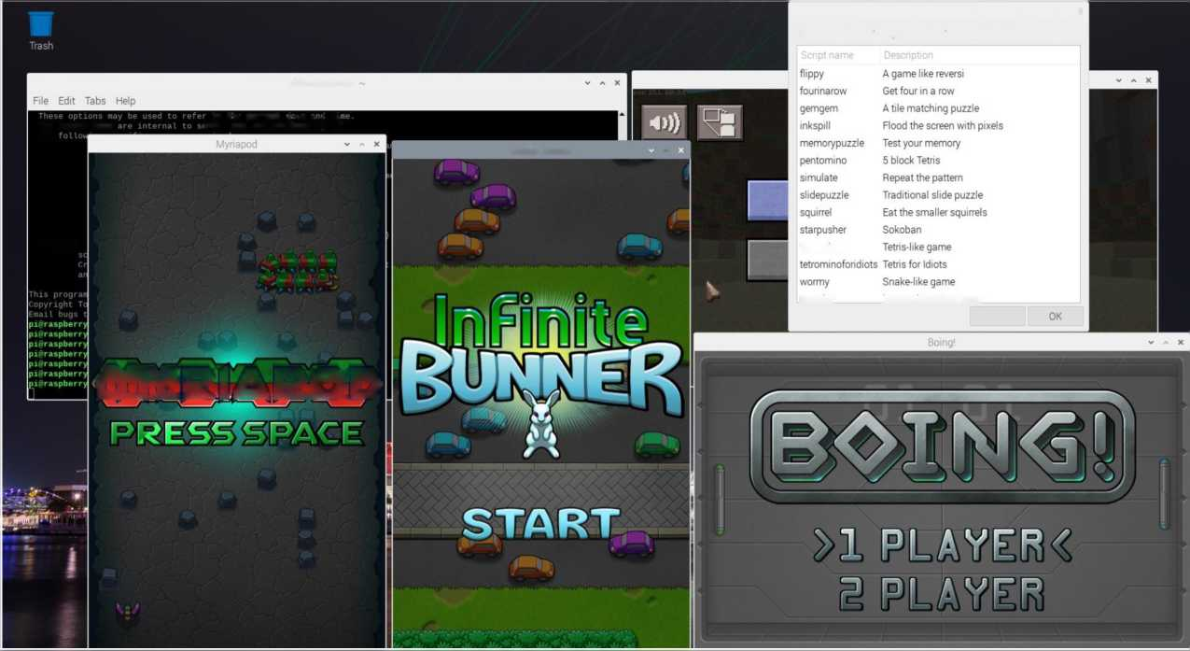
lpi(S>raspberrypi
*Minecraft - Pi edition ^"[Scratch Desktop]
iBoing!
Infinite Bunner
I Myriapod
j Choose the Python g
t T ♦»
Choose the Python game to launch v ^ x Games by Al Sweigart Manual at mventwithpython.com/pygame
pi@raspbenypi:
The second kind The
to the current date and tin :rot and are prefixed by '$'
Infinite Bunner
Example;
tetromino
website
mventwithDvthon.com
Cancel
mY:E?IABOE>
Figure 12: b.) Multiple Games in Raspberry Pi 4 8GB model B
PROJECT COMPUTING | Raspberry Pi Tiny, Portable, and Powerful PC

Slide 16

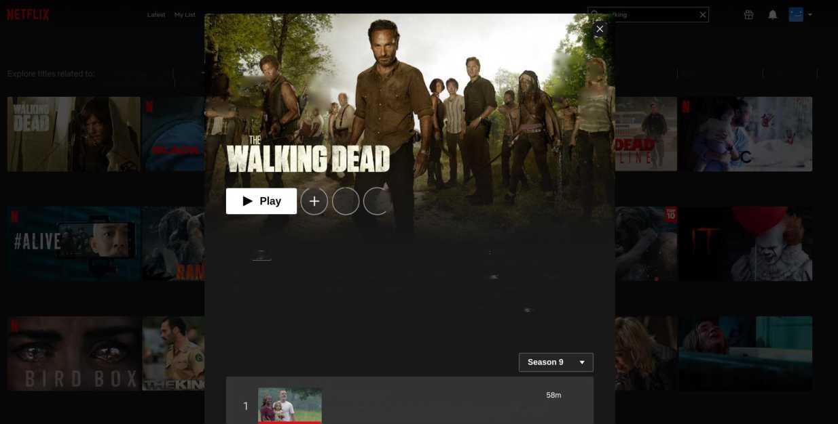
lpi@raspberrypi: -
Minecraft - Pi edition [Scratch Desktop] ^ Netflix - Chromium
Netflix - Chromium
Netflix x +
-> C 8 netflix.com/search⁷q=walking&jbv=70177057
Home Series Rims
KIDS
BF‘"‘♦
The Walking Dead The Wc 1 ;
JM I
_{t}.i- ^Vj. ill; Lone Justice Walking on Sunshine
Walking Out
Dead Man Walking Walkin
*v.
IF*-., i/f j
f \ -
¹ • fc-r i'l' ."^{v}
_ _.
ARGO
4 9)
2018 pTsin 9 Seasons ^{Casl And,ew L}"’^{c}°^{ln}-^{S,evs}" ^{Yeun}'
Norman Reedus, more
In the wake of a zombie apocalypse, survivors hold on to the Genre TV shows Based on comics,
hope of humanity by banding together to wage a fight for their Drama Programmes, Horror
Programmes
own survival.
This programme I Ominous, Scary, Suspenseful
MAN*
Episodes
A QUIET PLACE
A New Beginning
As peace breaks out, Rick struggles to realize Carl's vision and build bridges between those left standing. But treachery forces Maggie to act.
Figure 13: c.) Streaming Netflix in Raspberry Pi 4 8GB model B
PROJECT COMPUTING | Raspberry Pi Tiny, Portable, and Powerful PC

Slide 17

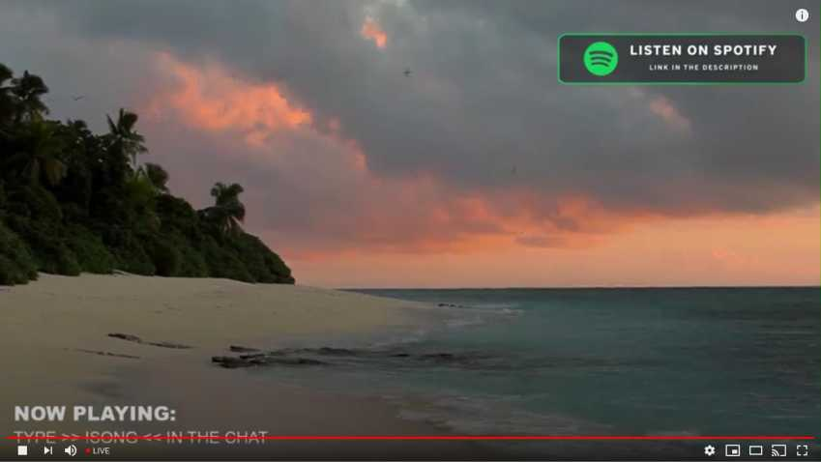

|pi@raspberrypi: ~ Minecraft - Pi edition ^^{m}\Scratch Desktop Ifo Thonny -/home/pi/... The Good Life Radio •...
t T 4» 16:47
 | The Good Life Radio • 24/7 Live Radio | Best Relax House, Chillout, Study, Running, Gym, Happy Music - YouTube - Chromium | V □ X
O The Good Life Radio x +
<- -> C £ youtube.com/watch?v=36YnV9STBqc |  | * ■ eb e :
= O YouTube
0 SIGN IN
Top chat ▼
m/plavlist?list...
SHUBH 4k mushroom soup Robertto Silva Os dogs amor kkk ANJALI., king say
A Aayat @Rover I am sorry. I didn't notice., but thank you for welcoming * * " * ■
0 JAQKIE KING IM ABHI Atul Gholia girl boss kya Mnflap A6flyn/iMH npHKonucTac
Bhoo_ Anjali name change kr V
Q ROG ffANJALI . ^ JfJ ft S* ^ Ficus anjali u ?
Laura Pergolizzl dpaTHK . n He 3Haio ee ^ SHUBH Ficus bas jee rhe h ap batao?
^ ANJALI , Abhi say why are u crying Slnoj Thomas Laura 100% ^
Monika Shubh eat it now
e
0/200 >-
fflhegoodlife #deephouse fftropicalhouse
The Good Life Radio • 24/7 Live Radio | Best Relax House, Chillout, Study, Running, Gym, Happy Music
6,999 watching now • Started streaming on Mar 28,2020
The Good Life Radio x Sensual Musique
Up next
AUTOPLAY
Summer Mix 2020 - Chillout Lounge Relaxing Deep House...
Shine Music 9 35M views • 2 years ago
lir 175K 4¹ 8.6K A SHARE ==+ SAVE ^
Figure 14: d.) Streaming YouTube in Raspberry Pi 4 8GB model B
PROJECT COMPUTING | Raspberry Pi Tiny, Portable, and Powerful PC

Slide 18
Task 5
a.) Summary
• In our modern era, we have developed and innovate technology immensely that we x50 billion computing power from the last 50 years since the 1970s.
• In the project, we will use the Debian Linux/GNU (Raspbian) Operating System. We will be formatting our SD card as Fat32 since xRaspberry xPi’s xbootloader, xbuilt intox the xGPU and xnon-updatable, only xhas xsupport reading xfrom xFAT xfilesystems (xboth xFAT16 and xFAT32), andx is unable xto boot from anx exFatx and NTFS xfilesystem.
• We will be setting up xNew xOut xof xBox xSoftware (xNOOBS) for anx easyx Operatingx Systemx installationx in our xRaspberry xPi 4 8gb model B.
• All of the OS (Operating System) from Windows, macOS, and Linux/GNU works for xRaspberry xPi x4 8GB xModel xB for it’s a very powerful single-board computer.
• I had fun and pleasure doing this project. It is always my ambition to build a xRaspberry xPi x4 x8GB xModel B currently most powerful xRaspberry xPi available in the market. Alternatively, we can use Nvidia Jetson Nano or Asus Tinker Box for more powerful and similar uses, etc.
• There’s a lot of Raspberry Pi alternatives available in the market.
• Raspberry Pi can have a lot of uses from regular Linux pc, server, VPN, and pentesting, etc. And to more sophisticated projects like Artificial Intelligence, Machine Learning, and Deep Learning, etc. here is the list of projects for https://proiects.raspberrypi.org/en.
• I have seen interesting use for Raspberry Pi like Automated facial camera CCTV recognition, Gardening having water, humid, and temperature, automation, etc. and Self-Driving Artificial Intelligence Cars having Machine Learning capabilities.
PROJECT COMPUTING | Raspberry Pi Tiny, Portable, and Powerful PC

Slide 19

• I have seen Raspberry Pi running 24/7, 7 days a week, it has a very low power
consumption so you don’t have to worry about your electricity bills.
• In my opinion, Raspberry Pi would be a great alternative for expensive, ponderous, huge, and clunky PC’s, if your interest is programming, coding, gaming, and pen-testing, etc. Raspberry Pi is a great alternative for it.
• Computers got more portable and compact in the last 57 years since 1943 first computer ENIAC invention occupying x1,800 xsquare xfeet andx usedx aboutx 18,000x vacuumx tubesx, xweighing almostx x50 xtons.
• In upcoming future, additional powerful single-board computers will have further capabilities than our current and modern PCs. NVIDIA TITAN V and
AMD Radeon RX 5700 likely will have supports for it.
References:
Bibliography
https://www.raspberrypi.org/ https://itsfoss.com/raspberry-pi-alternatives/ xhttps://en.wikipedia.org/wiki/Computer#First computing device
PROJECT COMPUTING | Raspberry Pi Tiny, Portable, and Powerful PC

